Slide 1

Fundamentals of Databases Medicine Inventory Management System
Kerolus Magdy
Abdelrhman ewais
Yousef tamer
Hanin waleed

Slide 2

Introduction
Purpose: Manage prescriptions, medicines, diseases, doctors, and bills.
Automates billing using triggers.
Supports simple & complex queries.

Slide 3
Requirements
Prescription: ID, Doctor, Date, Medicines, Quantity, Patient Name
Medicine: ID, Name, Manufacture Date, Expiry Date, Price, Diseases, Dosage
Bill: ID, Prescription, Tax, Discount, Total
Disease: ID, Name, Type
Doctor: ID, Name, Qualification, Specialization

Slide 4
Conceptual Design
Entities: Doctor, Disease, Medicine, Prescription, PrescriptionItem, Bill, MedicineDisease
Relationships:
- Doctor → Prescription (1:N)
- Prescription → PrescriptionItem (1:N)
- Medicine ↔ Disease (M:N)
- Prescription → Bill (1:1)

Slide 5
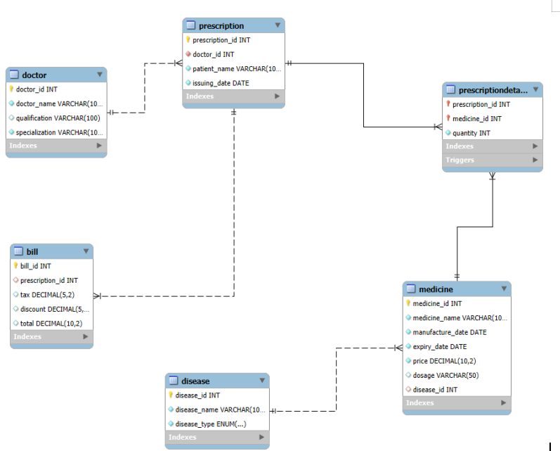
ER Diagram

Slide 6
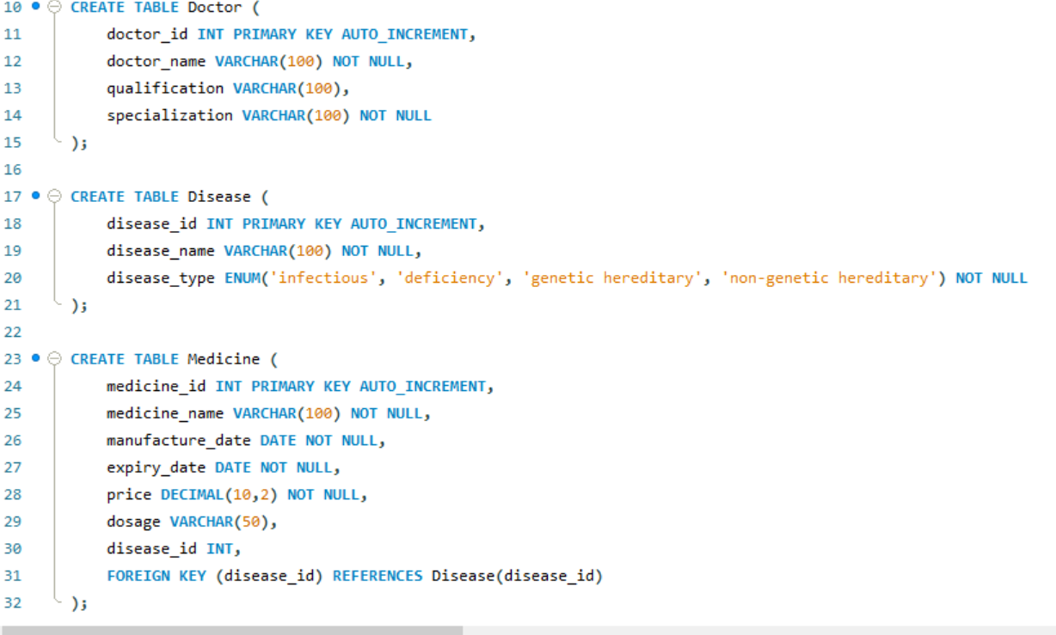
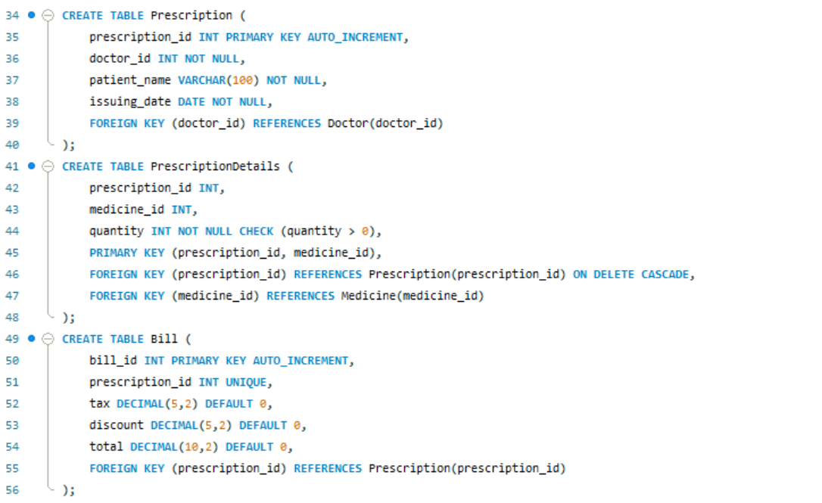
Relational Schema
Tables: Doctor, Disease, Medicine, Prescription, PrescriptionItem, Bill, MedicineDisease
Keys: PKs for IDs, FKs for relationships
Constraints: NOT NULL, UNIQUE, CASCADE rules

Slide 7
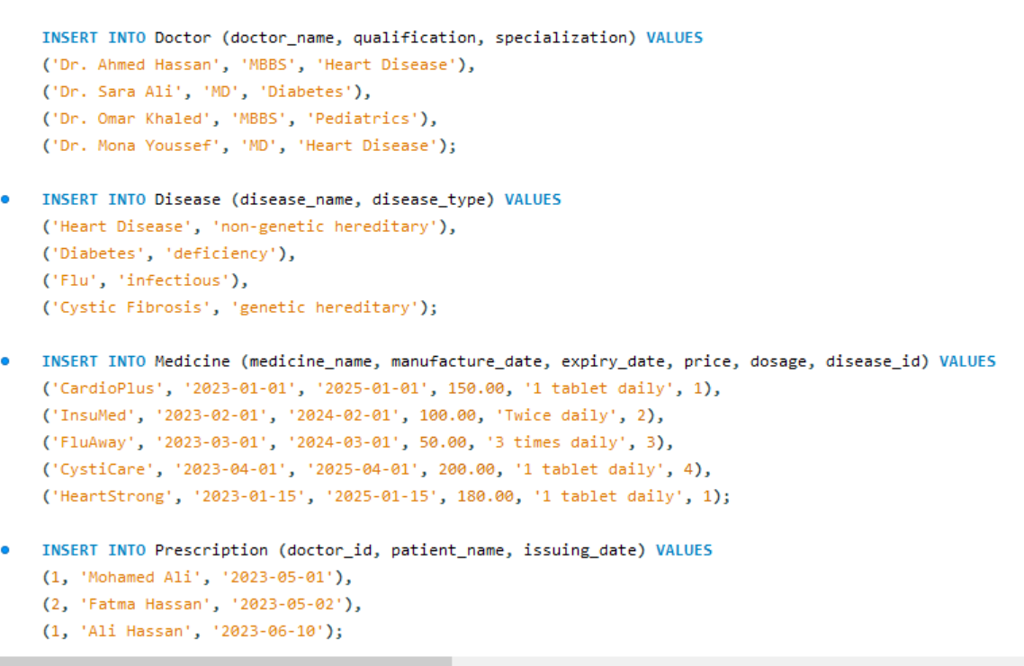
Implementation (DDL & DML)

Slide 8
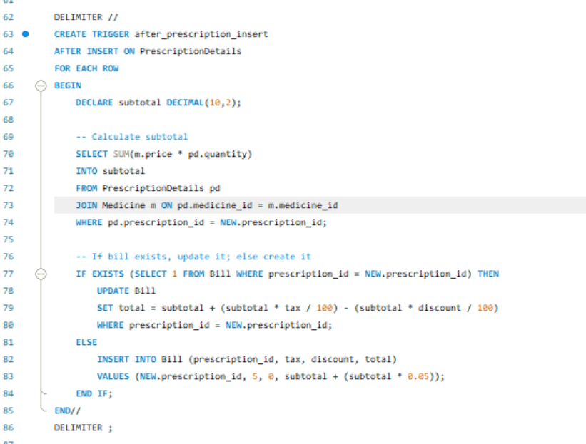
Triggers
After INSERT/UPDATE on Prescription → calculate Bill
After changes in PrescriptionItem → update Bill total

Slide 9
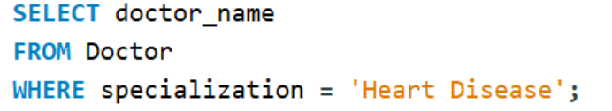

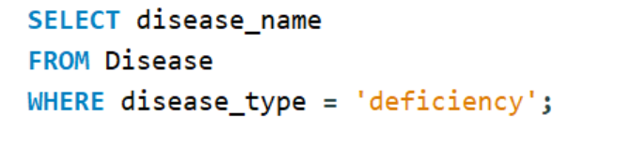
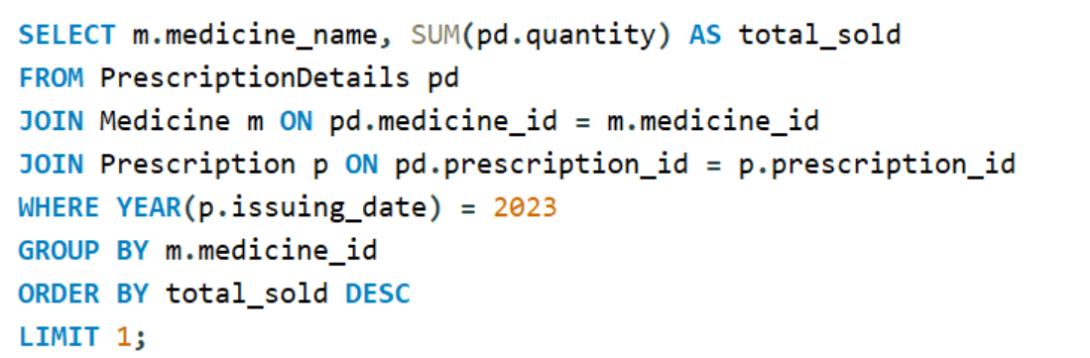
Sample Queries
Doctors specializing in heart disease
List deficiency diseases
Most sold medicine in 2023

Slide 10
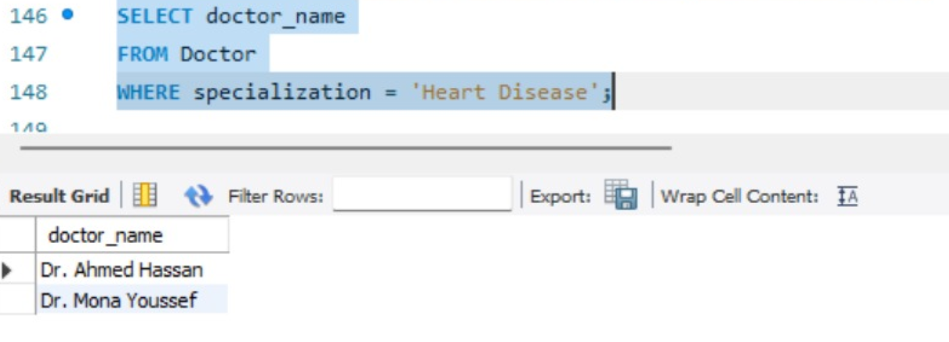
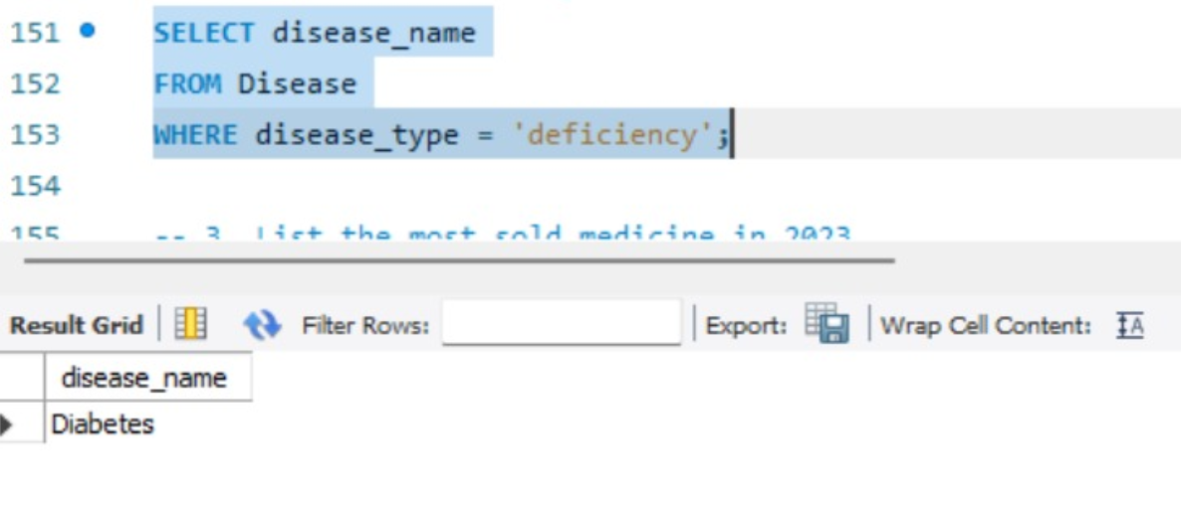
Results
Doctors specializing in heart disease
List deficiency diseases

Slide 11
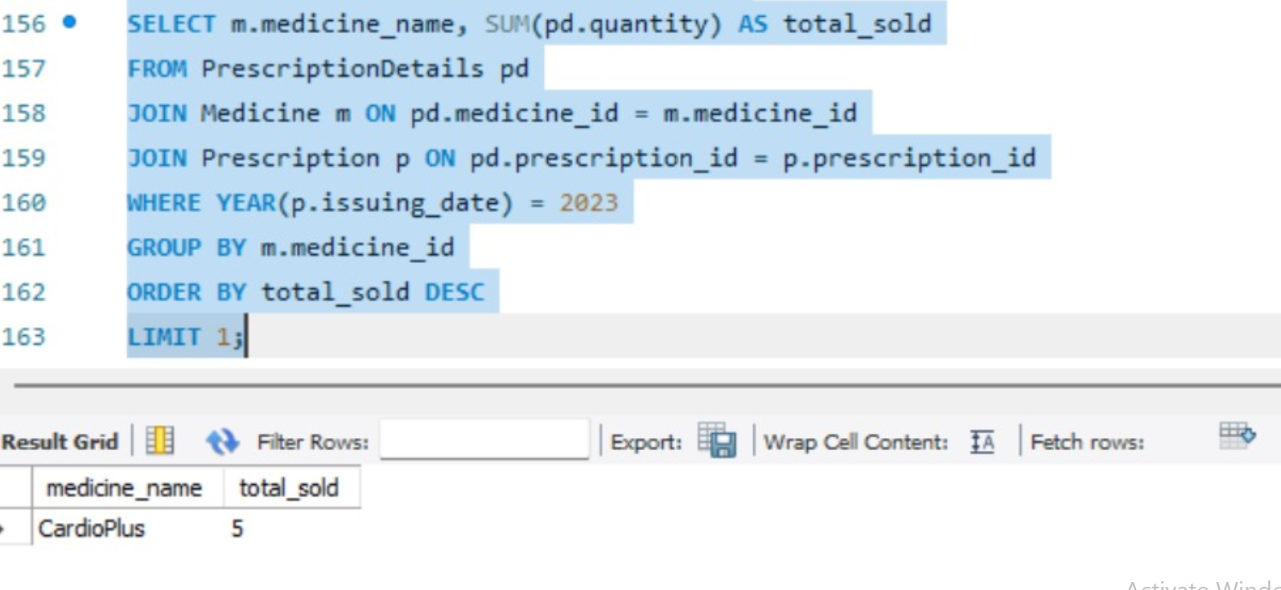
Results
Most sold medicine in 2023

Slide 12

Bonus Explanation video UI application

Slide 13
Thank you

